Slide 1





GISHydroWEB
A Web-Based Hydrologic Analysis Tool for Maryland
(Latest Updates and Future)

Slide 2
GISHydro History
Dr. Robert Ragan (UMD) developed QuickBasic-based GISHydro tool for SHA
Contained land use and soils data for Maryland
Enabled rapid, automated hydrologic analyses

Slide 3





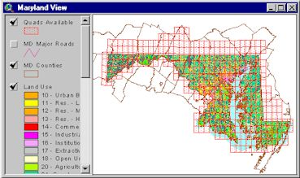
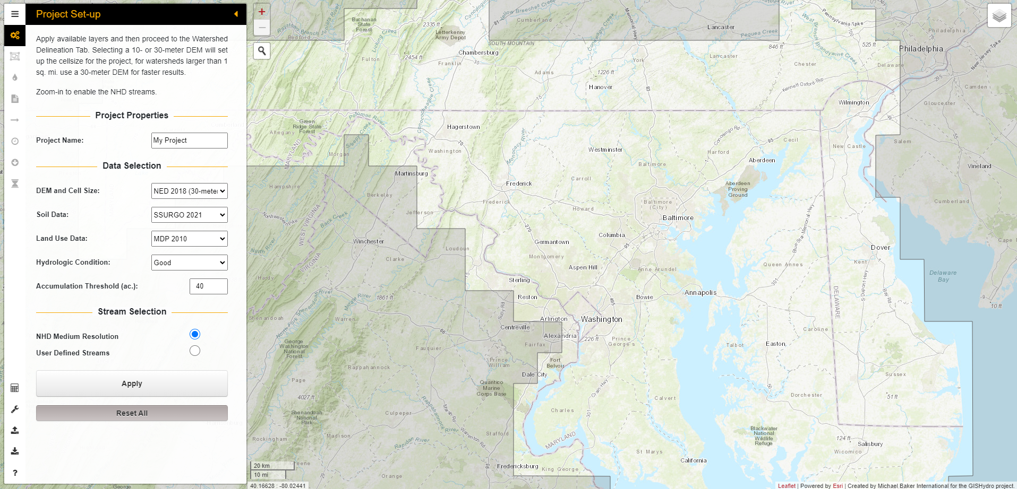
GISHydro History
From our humble beginning in 1940, we now work on some of the most impressive projects across the country and around the world.

Slide 4
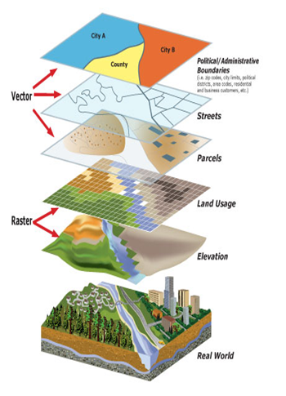



Overview
Python-ArcGIS Geoprocessing API
Enables engineers to perform rapid, automated hydrologic analyses
Data from different agencies and sources (e.g., USGS, EPA, NRCS, NOAA, MDOP)
An example of map layers used together in GIS.
San Bernardino County GIS Dept, 2012. Used for education purposes only. http://gis/subcounty/gov

Slide 5

Hydrologic Analyses
On-the-Fly Delineation
Fixed Region Regression Equations (FRRE)
Time of Concentration
Download GIS Features
And more …
WinTR-20 Input and Output files

Slide 6
Interface and Access
GISHydroWEB (Beta Version)
maps.roads.maryland.gov/gishydro/
Browser recommendations (for now):
Chrome (preferred)
Firefox
Edge

Slide 7
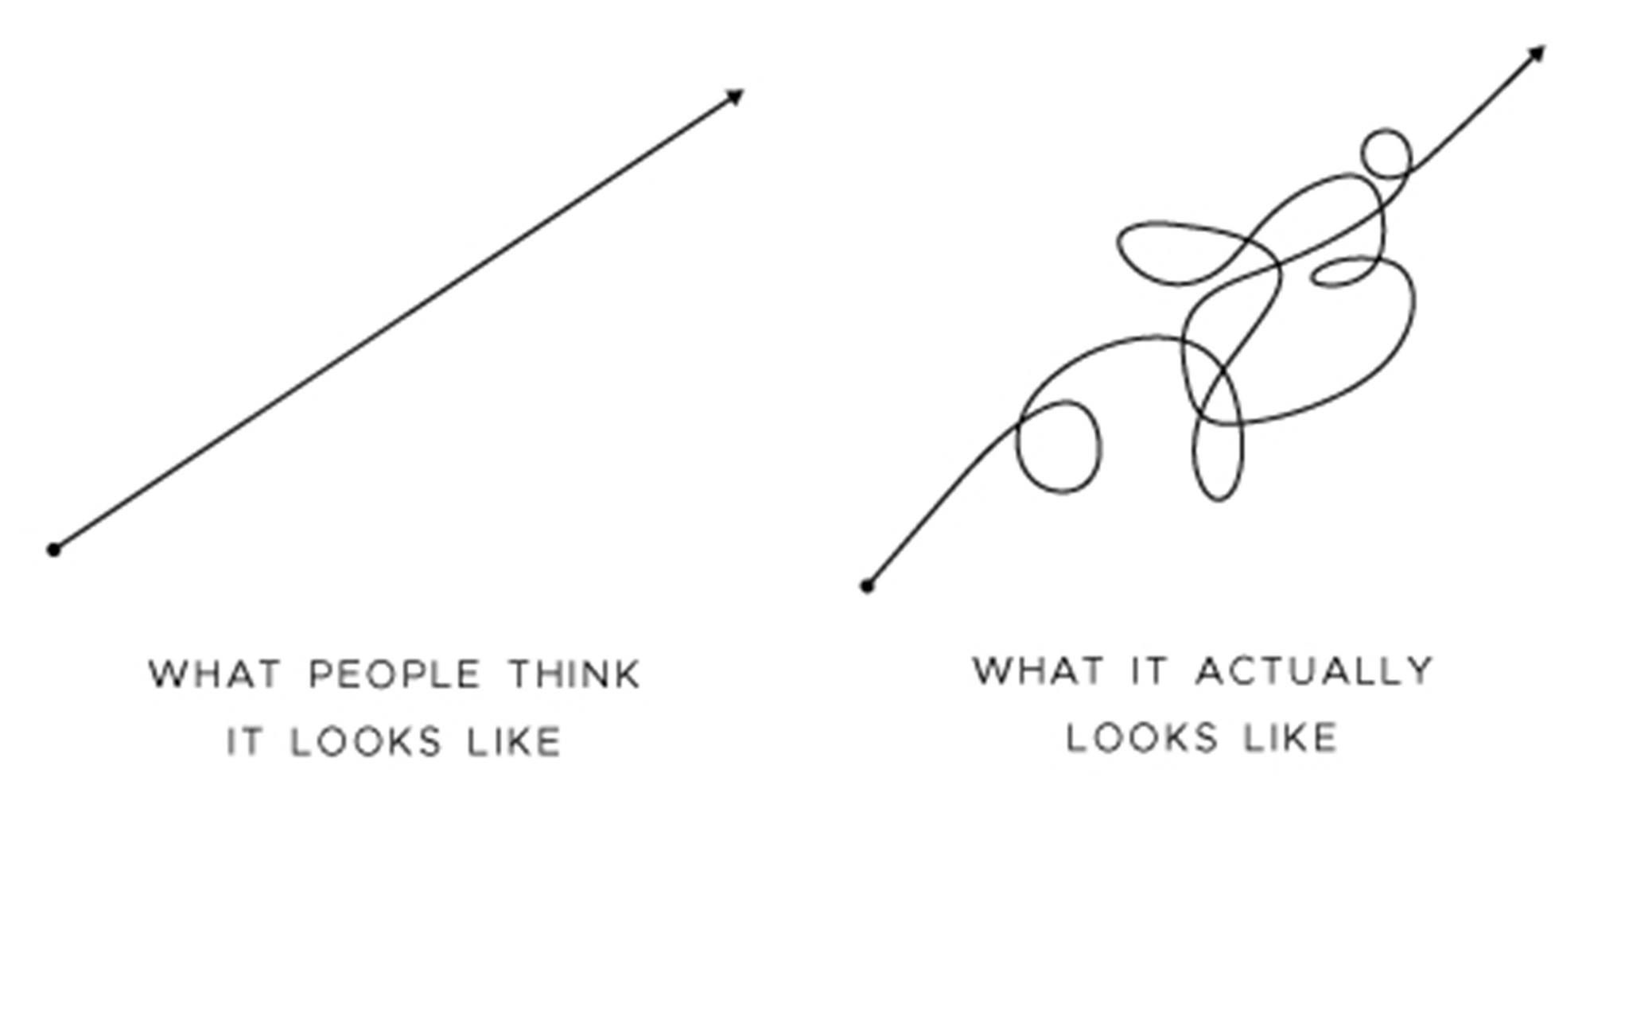
What Has Changed?
GISHydroNXT has been deprecated and is no longer available online
Datasets and layers are now hosted on ArcGIS Servers (Faster!)
Improved and enhanced geoprocessing capabilities
Updated Fixed Region Regression Equations
Progress

Slide 8
NXT vs WEB
Issues with user access through NXT platform
Need for more open and easy access
GISHydroWEB cannot create maps on the fly like ArcMap
Users can download project layers and create maps locally
Nicer and more straightforward interface compared to ArcMap toolbar

Slide 9
Why not simply use USGS StreamStats?
More personalized to meet Maryland SHA standards
Fast integration of updates
Features such as computing Tc and running WinTR-20
SS Regression Equations are dated from 2010

Slide 10
To-Do’s
Comprehensive and accurate documentation
Metadata and data access
Implement the latest updates to the FRRE
Collaborate closely with SHA IT staff to provide better user support.
Formalize GISHydroWEB as an official tool!
Update Ultimate Land Use
More Testing!

Slide 11




Future Tasks
Batch Analysis
Update Datasets (Land Use, Soils, DEM)
Integrate HEC-HMS
Custom User Defined Watershed Layers
Provide Training Sessions (maybe?)
Integrate StreamStats (maybe?)
11

Slide 12
Conclusion
Helps engineers perform rapid, automated hydrologic analyses.
The tool is available in Beta version, in the final review stage for official use
HEC-HMS, new datasets, and other features to come
maps.roads.maryland.gov/gishydro

Slide 13

Contact Information
GISHydro Project
gishydro.eng.umd.edu
To report bugs, email:
gis@mdot.maryland.gov

Slide 14

Acknowledgements
Hydrology Panel Members
Wilbert Thomas, Chair (Michael Baker)
Kaye Brubaker (UMD)
Glenn Moglen (UNC)
Quan Quan (USDA)
Richard Berich (EBA Eng.)
Javier Mardones (Michael Baker)
Supporting Agencies
Dana Havlik (SHA)
Andrzej Kosicki (SHA)
Pawel Mizgalewicz (SHA)
Jeremy Mondock (SHA)
Kristianne Sandoval (SHA-RKK)
Dave Guignet (MDE)
William Seiger (MDE)

Slide 15
GISHydroWEB
A Web-Based Hydrologic Analysis Tool for Maryland
(Latest Updates and Future)

